Slide 1
University of Guelph Faculty and Administration Town Hall
Dr. Nicola Mercer
Medical Officer of Health and CEO
Wellington-Dufferin-Guelph Public Health
June 3, 2021

Slide 2
Presentation overview
Short recap of our local vaccine progress
Answering your COVID-19 questions
We received over 40 questions from the UGFA!
We will do our best to answer all questions in the time we have
Questions which were on the same theme are grouped together whenever able

Slide 3
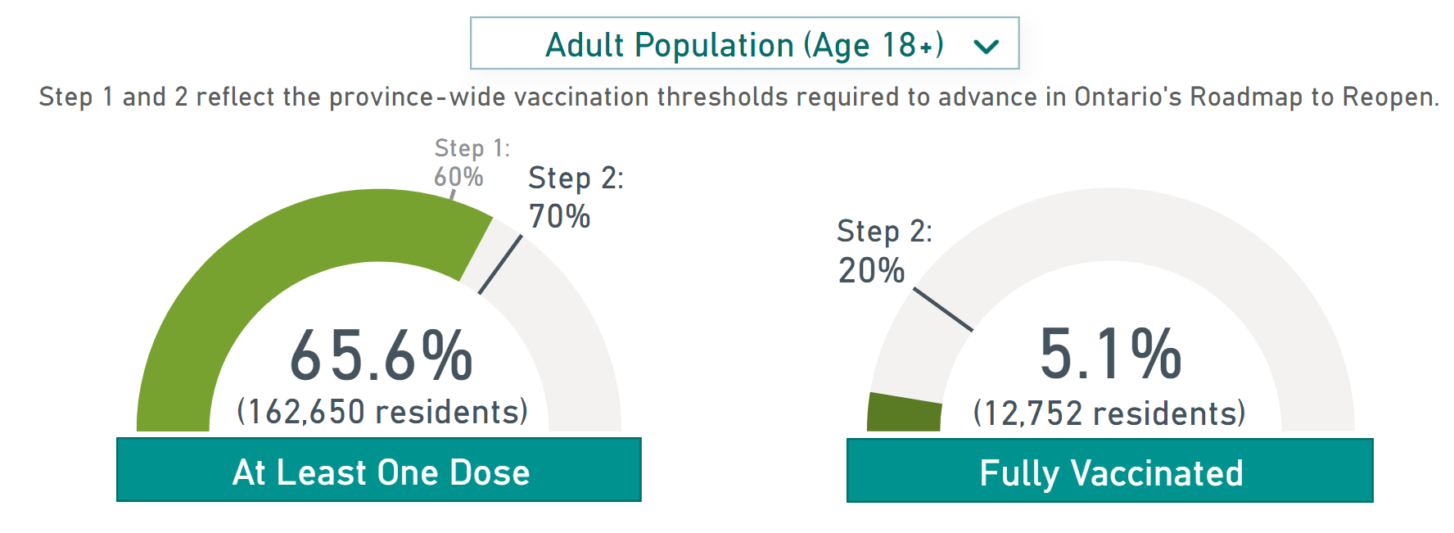
Local COVID-19 vaccine program
Updated: June 2, 2021. Reflects totals from 8 p.m. the previous business day
From: www.wdgpublichealth.ca/vaccine

Slide 4
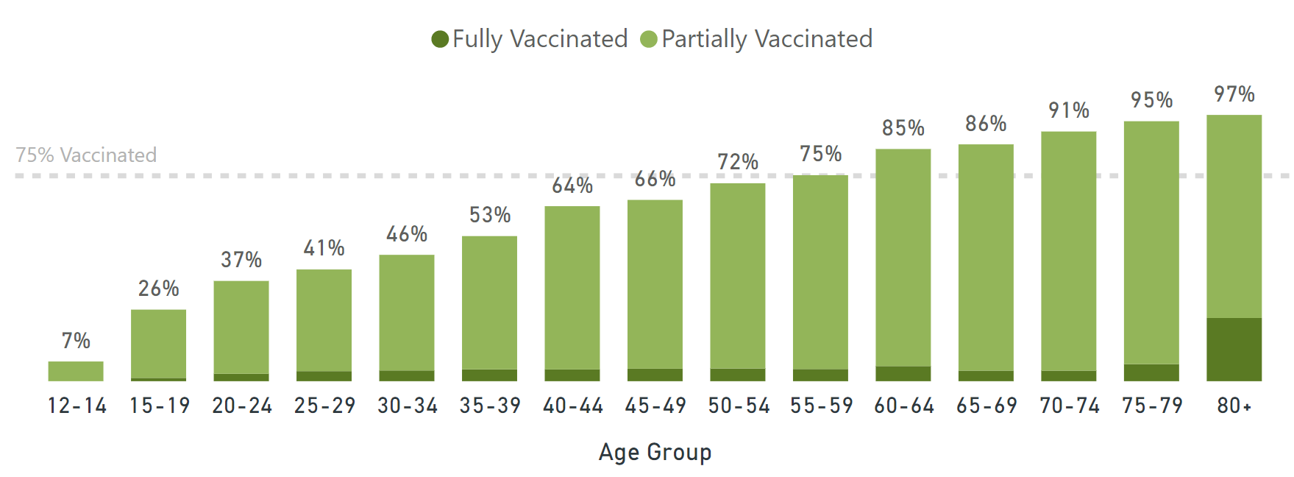
Who has been vaccinated locally?
Updated: June 2, 2021
Wellington-Dufferin-Guelph Public Health. COVID-19 Vaccination Report. Available from: https://wdgpublichealth.ca/vaccine

Slide 5
Ontario’s COVID-19 Roadmap to Reopen

Slide 6
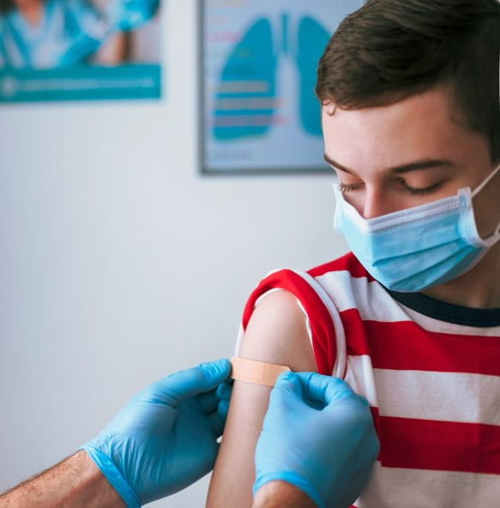
COVID-19 vaccine milestones in WDG
25% one dose
April 14
June 28 (Projected; based on an ideal scenario)
May 17
50% one dose
60% one dose
May 28 (Projected)
70% one dose 20% two dose

Slide 7
What can be done now to ensure the safest possible return to campus in the fall?
To control COVID-19 on campus, we must control it in the Guelph community.
Steps we can all take:
Get vaccinated (if you are already vaccinated yourself; help a friend or family member)
Wear a mask
Physically distance when able
Stay home if you feel sick
Follow current Provincial guidelines

Slide 8
Your questions: Vaccine effectiveness

Slide 9
How long does immunity take to develop and how long will it last?
You asked:
“If I do not get a second dose until mid-August, would I have full immunity in time for classes to begin?”
“…How do we know when/if our own immunity or those of others expires? Will boosters be needed? Will completely new vaccines need to be developed?”
Efficacy trials for the Moderna and Pfizer vaccines demonstrated 90+% and 95% efficacy, respectively, seven days after dose two was administered.^{1,2}
Several studies have shown that natural immunity can last at least six months. Vaccine-induced immunity is expected to be longer-lasting. Longitudinal studies are underway to monitor this.
1. Baden LR, El Sahly HM, Essink B, et al. Efficacy and Safety of the mRNA-1273 SARS-CoV-2 Vaccine. N Engl J Med, February 4, 2021; 384:403-416. DOI: 10.1056/NEJMoa2035389
2. Polack, FP, Thomas SJ, Kitchin N, et al. Safety and Efficacy of the BNT162b2 mRNA Covid-19 Vaccine. N Engl J Med 2020 December 31, 2020; 383:2603-2615; DOI: 10.1056/NEJMoa2034577

Slide 10
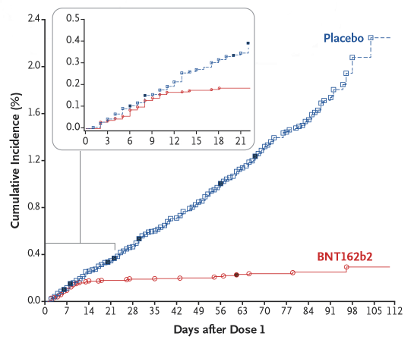
What is the efficacy of the vaccines?
Vaccine | Efficacy 14 days after dose 1 and before dose 2 | Efficacy > 7-14 days after dose 2
Pfizer-BioNTech | >90% | >90%
Moderna | >90% | >90%
Oxford-AstraZeneca | >70% | >80%
Janssen-J&J | 67% | N/A
Image credit: New England Journal of Medicine
Source: Ministry of Health. COVID-19 Vaccine Information Sheet. Available from: https://www.health.gov.on.ca/en/pro/programs/publichealth/coronavirus/docs/vaccine/COVID-19_vaccine_info_sheet.pdf

Slide 11
How well have the vaccines worked in Ontario?
True ‘breakthrough cases’ are rare
3,493,866 total participants studied:
99.8% No COVID-19 reported
0.13% COVID-19 reported – Not yet protected (<14 days after first dose)
0.056% COVID-19 reported – Partially vaccinated
0.0074% COVID-19 reported – Fully vaccinated (>7 days after second dose)
Source: Public Health Ontario. Enhanced epidemiological summary- Confirmed cases of COVID-19 following vaccination in Ontario: December 14, 2020 to April 17, 2021. May 5, 2021. Available from: https://www.publichealthontario.ca/-/media/documents/ncov/epi/covid-19-epi-confirmed-cases-post-vaccination.pdf?la=en

Slide 12
Efficacy against variants
You asked:
“What is the possibility of new vaccine-resistant strains emerging. How quickly could they be identified?”
“…does the AstraZeneca vaccine provide sufficient protection against the B.1.617 variant (to allow for) going to a large lecture hall with about 250 students.”
It is likely that new variants will continue to emerge as long as the virus circulates
Recent preprint article form Bernal et al. has shown that the AZ vaccine is less effective against the B.1.617.2 variant, especially after one dose
Current evidence seems to indicate that there will always be some risk of transmission, regardless of the specific variant
However, there are steps that can be taken to reduce the risk of transmission (e.g., masking, maintaining distance from students)
Bernal JL, Andrews N, Gower C, et al. Effectiveness of COVID-19 vaccines against the B.1.617.2 variant. Public Health England preprint, May 2021

Slide 13
Your questions: Vaccine availability

Slide 14
Expected Vaccine Shipments for WDG
Week | Pfizer
May 31 | 17,550
June 7 | 15,210
June 14 | 15,210
June 21 | 15,210
June 28* | 15,210
July 5* | 14,040
*Planned dose allocation; not yet confirmed
Note: Additional doses of Pfizer are being distributed to local pharmacies. For example, for the week of May 31, WDG pharmacies were allocated an additional 3,120 doses

Slide 15
Expected Vaccine Shipments for WDG
Moderna:
Early June: 155,600 doses across all Ontario PHU regions (including public health units, pharmacy and primary care offices). More information about local allocation is expected soon
AstraZeneca:
There is a pause on first doses of this vaccine
22,918 first doses have been distributed in WDG
Dose shipments are expected to match original distribution of dose one for our area

Slide 16
Vaccine availability in WDG
You asked:
“No one knows when people will receive their second dose.”
“…will there be enough vaccines for second doses. Will there be enough health staff to administer first doses to teenagers and second doses to others in a timely fashion?”
The Federal government projects that there will be enough COVID-19 vaccines coming into the country to offer every eligible and willing Canadian their first shot by this summer, and enough doses for everyone to be fully vaccinated by September
The Provincial government has echoed these comments, calling for a “two-dose summer”
Our local projected dose allocations support this

Slide 17
Expected dose interval this summer
You asked:
“Will the policy to delay the does 3-4 months continue?...”
Extending second doses to 16 weeks was necessary in the spring due to vaccine availability
If supply continues to be reliable throughout the summer, it is anticipated that the interval between doses can be shortened
In August, we anticipate to be prioritizing second doses of vaccine for young adults and school-aged children

Slide 18
Vaccine dose intervals
Modelling data indicate that in certain conditions, a beneficial trade-off can be made of lower vaccine efficacy (single dose) but higher population vaccination coverage and therefore population-wide covid-19 immunity.¹
A UK study of 175 people over 80 years of age found that those who received the second dose of Pfizer vaccine at an extended interval of 12 weeks had a higher peak antibody response than those that received their second dose at the three-week standard interval.²
1. Romero-Brufau S, et al. (May 12, 2021). Public health impact of delaying second dose of BNT162b2 or mRNA-1273 covid-19 vaccine: simulation agent based modeling study. bmj; 373.
2. Parry, H.M. et al. (May 17, 2021). Extended interval BNT162b2 vaccination enhances peak antibody generation in older people. Pre-print article from medRxix.

Slide 19
AstraZeneca- Access to dose two
You asked:
“I received my first dose of AstraZeneca about 8 weeks ago, but I am now worried that I may have a difficult time accessing a second dose.”
“Does Public Health have any ability to help us sign up for or distribute these limited availability second AZ doses for those of us who still want one?...”
The National Advisory Committee on Immunization (NACI) recommends when the first dose is the AstraZeneca/COVISHIELD COVID-19 vaccine that either AstraZeneca/COVISHIELD OR an mRNA COVID-19 vaccine may be offered for the subsequent dose in a vaccine series. The previous dose should be counted, and the series need not be restarted.¹
The choice can be discussed with your care provider and will be made with the individual’s informed consent.
National Advisory Committee on Immunization. NACI Rapid Response: Interchangeability of Authorized COVID-19 Vaccines. 2021 June 1. Available at: https://www.canada.ca/content/dam/phac-aspc/documents/services/immunization/national-advisory-committee-on-immunization-naci/naci-rapid-response-interchangeability-authorized-covid-19-vaccines-en.pdf

Slide 20
Your questions: Vaccine uptake and administration

Slide 21
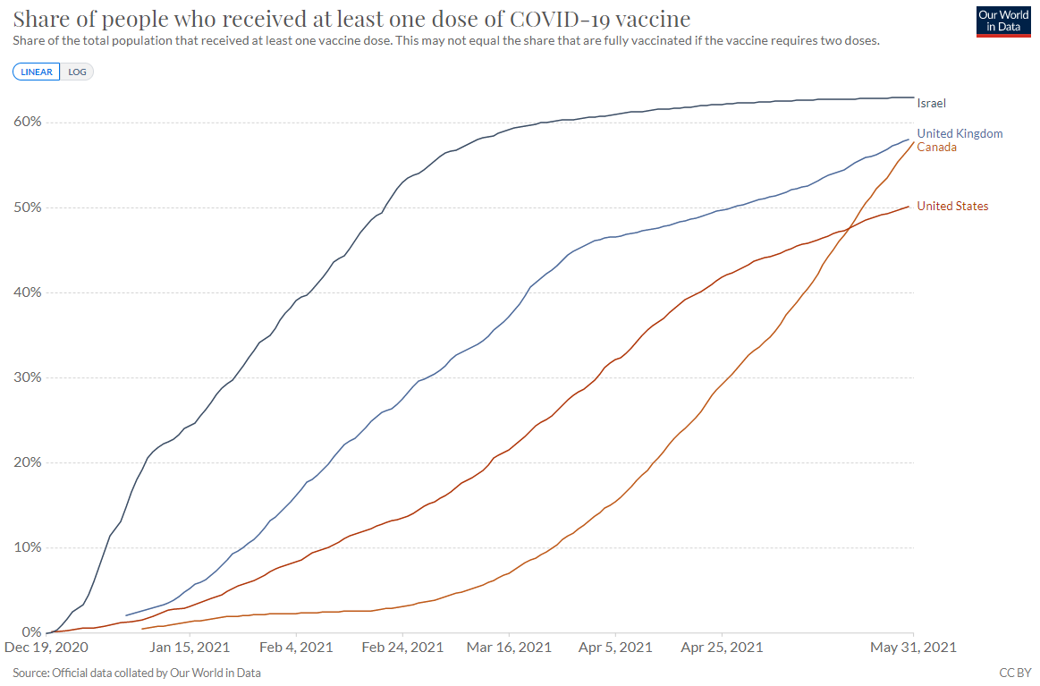
Vaccine uptake
Canada has surpassed the US in % of people who have received at least one dose of the COVID-19 vaccine
It is estimated Canada will surpass the UK this week
Available from: Our World in Data. Coronavirus (COVID-19) Vaccinations. Accessed on: June 1, 2021. Available from: https://ourworldindata.org/covid-vaccinations

Slide 22
Expected vaccine coverage in 17-22 year olds
You asked:
“What are the projections and targets for vaccination for September 1st , within the 17 – 22 year old age group.”
All Ontario students should have access to at least one dose by June 2021. The month of August is being used to prioritize second doses for this group.
To date, our younger populations have had limited access to vaccines, however early data from regions such as Peel which have had vaccines available to young people longer suggests good uptake in this age group.

Slide 23
How will we know who is vaccinated and who isn’t?
You asked:
“How can we guarantee … that individuals (both those from Ontario and out of province) claiming “vaccinated status” are really vaccinated?”
In many settings we will not be able to guarantee who may be vaccinated
There is no known percentage of vaccine coverage that can guarantee absolute safety
In some settings there will be mechanisms in place to track vaccination status (e.g., immunization policies for Long-Term Care Homes in Ontario, travel restrictions)

Slide 24
Consent for vaccination
You asked:
“Will children be vaccinated in Ontario without parental consent…”
There is no age of consent for medical procedures in Ontario. Anyone getting the COVID-19 vaccine, including youth, must provide informed consent.
Informed consent means that you understand:​
what the vaccine involves (for example, how it is given and what possible side effects there may be)​
why it is recommended​
the risks and benefits of getting or not getting it​

Slide 25
Recognizing international vaccination records
You asked:
“I received my first dose in Guelph and will likely not receive my second dose before travel. Is there a formal process to officially register in Ontario as fully vaccinated after receiving the 2nd dose abroad?”
There will be a process for registering as fully vaccinated in Ontario’s system. We expect more information on this soon.

Slide 26
Immunity following COVID-19 infection vs. immunity following vaccination
You asked:
“…why would we vaccinate those that have previously recovered from covid…”
“A recent study demonstrated that there may be a far higher frequency of naturally acquired immunity among Canadians…Will the local public health unit support the offering of voluntary testing to members of the university community to determine if they have evidence of SARS-CoV-2-specific immunity?”
The recommendation is to vaccinate these individuals
The health unit would not recommend using antibody testing as a means of determining probable resistance to future infection or as a substitute for vaccination

Slide 27
Your questions: Returning to campus

Slide 28
Returning to campus
You asked:
“…is it realistic assumption that the conditions in September and the Fall term will be such that it will be safe for most students to return to campus and for the faculty (in particular a vulnerable faculty) to teach them face-to-face without a mask and physical distancing.”
“Do you expect that 2 meters physical distancing be required in classrooms in September”
It is reasonable to expect a return to on-campus, in-person learning this fall.
Masking will continue to be important until we reach high levels of vaccine coverage.
Getting immunized before September reduces your risk.

Slide 29
Vaccination and returning to campus
You asked:
“What percentage of students, faculty, and staff should be fully vaccinated …to safely resume face-to-face classes…?”
“…what can be done to make sure that (students who are not fully vaccinated) will not affect our campus and our community...”
“What will the local public health unit's policy be for those who want to return to campus without receiving a COVID-19 vaccine?”
There is no known vaccine coverage that can guarantee the absolute safety from COVID of a group of people and this is unlikely to change for many years
Be a role model, get vaccinated and encourage others to be vaccinated
Based on results in other jurisdictions, we expect vaccination rates among students to be high. In other parts of the world, we see vaccination rates of above 65% in young people

Slide 30
Risk of outbreaks on campus
You asked:
“If there have be significant outbreaks in residences, is there any reason to believe these would not occur in classes?”
In general, congregate settings like residences are at a higher risk for outbreaks because students spend long periods of time there without masks.
It is possible for there to be outbreaks in classes, just as it is possible wherever people gather closely and/or indoors (e.g., movie theatres, restaurants, bars, religious venues).

Slide 31
Travel to and from campus
You asked:
“…what can be done to make sure that commuting students (e.g., students from other health unit areas) will not import cases to our campus & Guelph and affect those of us who are vulnerable or have vulnerable family members?”
There are steps we can take as individuals to protect ourselves and our vulnerable family members. The most important is to get fully vaccinated as soon as you are able.
The risk on campus would be similar to the overall community risk in Guelph. Individuals currently travel between health unit regions in Ontario for a variety of reasons, such as essential work. There is no way to guarantee that a case won’t be on campus.
Measures such as active screening, physical distancing, and masking help to reduce the risk on campus. These measures will be important as long as COVID-19 is active in the community.

Slide 32
Risk related to crowding
You asked:
“In the past, it has been common to see potentially hundreds of students waiting in the hallway outside of a room. Is there any amount of time at which this crowding remains safe?”
The shorter the time for which students are in contact, the lower the risk of transmission.
Masking is a mitigating measure.
Remember, risk is not only present when you see it on campus. Contact between members of the U of G community, particularly off campus, will be very difficult to enforce.

Slide 33
Bottom Line:
The best way to protect yourself and those in your household is to be vaccinated
Vaccines are safe and effective
We expect to have enough vaccine for two doses for those who want it prior to September
Wear a mask if you are not able to remain physically distant
COVID-19 is likely to be with us for years to come

Slide 34
Thank you! To stay up to date on our local vaccine rollout visit wdgpublichealth.ca/vaccine

